Slide 1
Student Rights Regarding Walkouts and Other Protests Haley Percell, OSBA Director of Litigation Spencer Lewis, OSBA Member Services Attorney Lauren Lewis, OSBA law clerk

Slide 2
Why are we having this webinar?
“#Enough The National School Walkout” is March 14 at 10:00 a.m.
Planned to last 17 minutes to honor the 17 students and staff members killed at Marjory Stoneman Douglas High School in Parkland, Florida.
Goal: A call to Congress to “pass legislation to keep us safe from gun violence at our schools, on our streets and in our homes and places of worship.”
Sponsored by Women’s March Youth Empower

Slide 3
Why are we having this webinar?
March 24, March of Our Lives Walkout, sponsored by the student-survivors of Parkland shooting
April 20, National High School Walkout for Anti Gun Violence, organized by students, anniversary of Columbine shooting

Slide 4
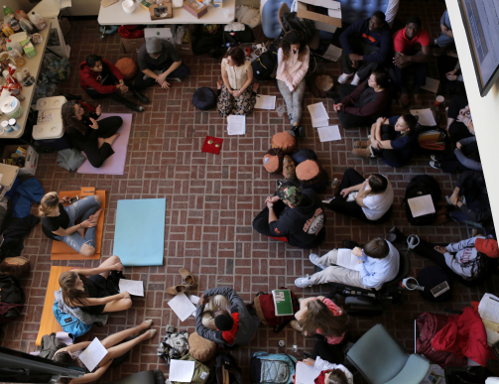
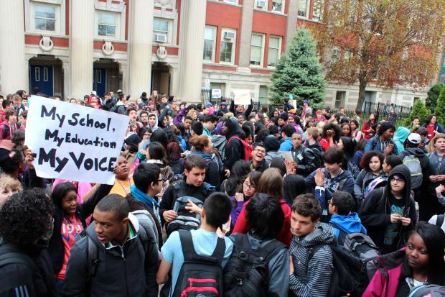
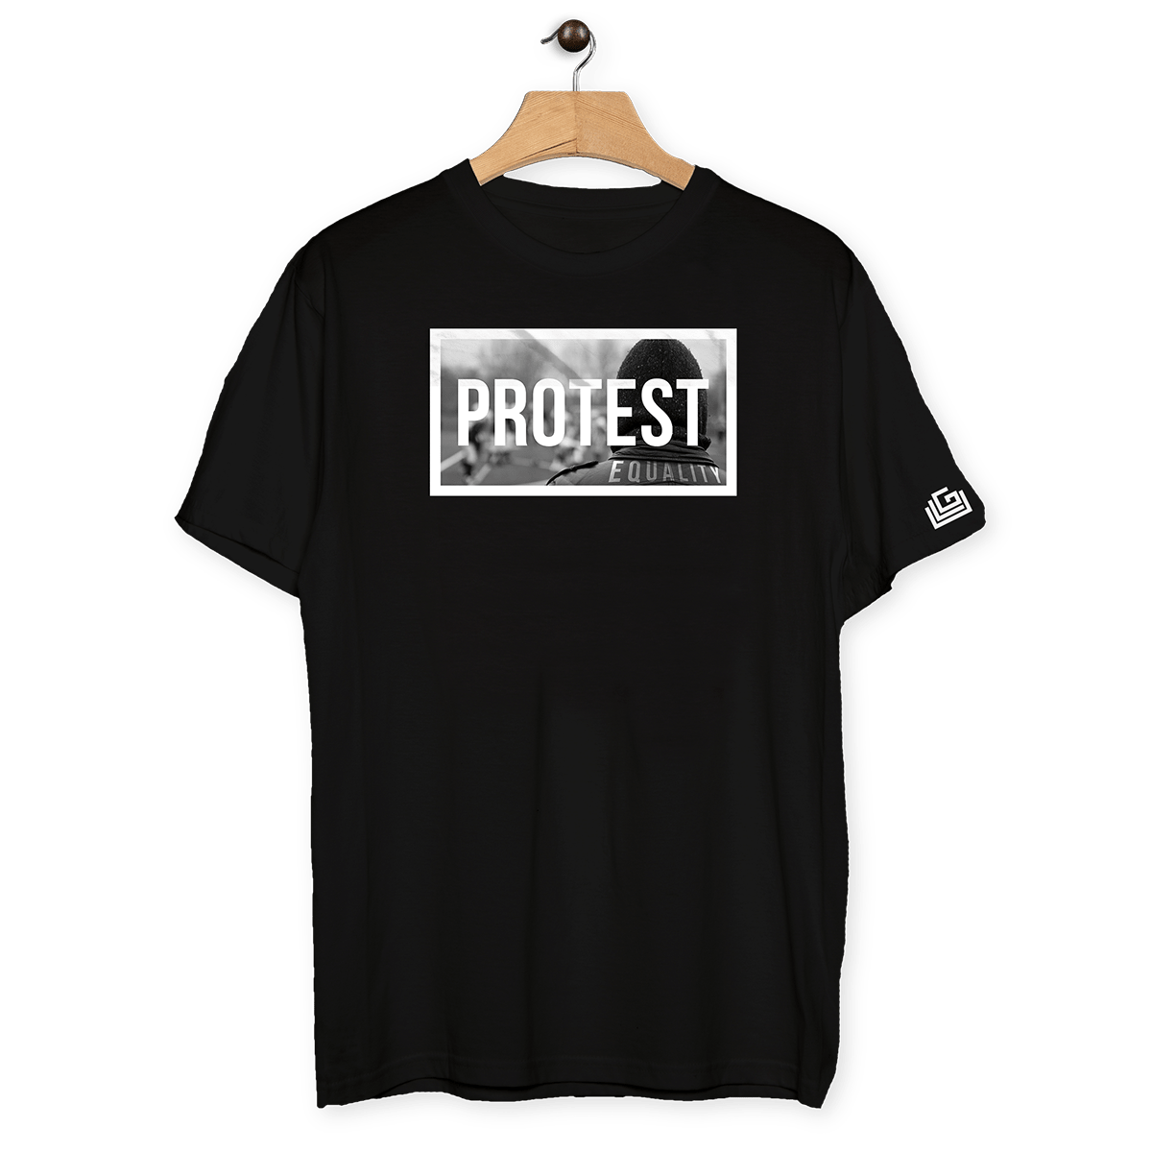
Types of Protesting
Sit-in
Walk-out
Clothing
Signs
Meetings
Kneeling
Notes:
Pictures: Left Top: Students participating in the sit-in protest at Syracuse University for the Diversity and Transparency Rally. (Photo by Luke Rafferty)
Right Top: Lincoln Park High School Walkout in support of a fired teachers. (2013)

Slide 5
Rights of Students + Schools:
Tinker v. Des Moines Ind. Comm. School Dist. (1969):
“[U]ndifferentiated fear or apprehension of disturbance is not enough to overcome the right to freedom of expression,” and the “mere desire to avoid the discomfort and unpleasantness that always accompany an unpopular viewpoint” cannot justify a school official's decision to punish or prohibit student speech.
Notes:
Tinker Notes:
Facts:
In protest to the Vietnam war, three students wore black arm bands to school in Des Moines. The school became aware of the plan to wear armbands and adopted a policy that any student wearing an armband would be asked to remove it or be suspended until they returned without the armband.
The rule of Tinker v. Des Moines Independent Community School District, that a decision to infringe upon student speech must be justified by facts that might reasonably have led a school district to forecast substantial disruption of or material interference with school activities, is a flexible one, and in applying it, the Court of Appeals looks to the totality of the relevant facts, including not only the students' actions, but all of the circumstances confronting the school officials at the time. Pinard v. Clatskanie Sch. Dist. 6J, 467 F.3d 755 (9th Cir. 2006)

Slide 6
Rights of Students + Schools:
Tinker v. Des Moines Ind. Comm. School Dist. (1969):
Students and teachers do not “shed their constitutional rights to freedom of speech or expression at the schoolhouse gate.”
Notes:
Tinker Notes:
Facts:
In protest to the Vietnam war, three students wore black arm bands to school in Des Moines. The school became aware of the plan to wear armbands and adopted a policy that any student wearing an armband would be asked to remove it or be suspended until they returned without the armband.
The rule of Tinker v. Des Moines Independent Community School District, that a decision to infringe upon student speech must be justified by facts that might reasonably have led a school district to forecast substantial disruption of or material interference with school activities, is a flexible one, and in applying it, the Court of Appeals looks to the totality of the relevant facts, including not only the students' actions, but all of the circumstances confronting the school officials at the time. Pinard v. Clatskanie Sch. Dist. 6J, 467 F.3d 755 (9th Cir. 2006)

Slide 7
Rights of Students + Schools:
Dariano v. Morgan Hill Unified School Dist. (2014):
“[S]tudents may ‘express their opinions, even on controversial subjects if they do so without materially and substantially interfering with the requirements of appropriate discipline in the operation of the school and without colliding with the rights of others.” (Internal quotations omitted, quoting Tinker).
Notes:
Tinker Notes:
Facts:
In protest to the Vietnam war, three students wore black arm bands to school in Des Moines. The school became aware of the plan to wear armbands and adopted a policy that any student wearing an armband would be asked to remove it or be suspended until they returned without the armband.
The rule of Tinker v. Des Moines Independent Community School District, that a decision to infringe upon student speech must be justified by facts that might reasonably have led a school district to forecast substantial disruption of or material interference with school activities, is a flexible one, and in applying it, the Court of Appeals looks to the totality of the relevant facts, including not only the students' actions, but all of the circumstances confronting the school officials at the time. Pinard v. Clatskanie Sch. Dist. 6J, 467 F.3d 755 (9th Cir. 2006)

Slide 8
Examples of Student Protected Speech:
Gay Activists Alliance student group was entitled to recognition as a student organization even when school philosophy differed.
Basketball players’ signed a petition and aired complaints against their coach, calling for his resignation.
Common Thread: First Amendment rights of expression must comport with the ability of schools to carry out their education mission.
Notes:
Examples of Free Speech Upheld:
Gay Activist Alliance v. Board of Regents of Univ of Ok, 638 P.2d 1116 (1981). Student activities group brought a suit against the University of Oklahoma after the University Student Organization refused to recognize the Gay Activities Alliance student organization. The court held that the GAA is entitled to be a student association and that UoK failed to show evidence that the group was disruptive or engaged in illegal activities. The school refused because they disagreed with the groups philosophy. A mere disagreement does not meet the Tinker 1st amendment analysis.
Pinard v. Clataskanie School Dist. 467 F.3d 755 (2006): 8 former members of the Clatskanie High School varsity boys basketball team sued after being suspended from the basketball team for signing a petition requesting their coach resign, not boarding a bus for an away game, and did not play in said away game. The court reasoned that because the plaintiffs' petition and grievances against Baughman are a form of pure speech, the defendants may not constitutionally punish the plaintiffs just for filing their petition or complaining about Baughman unless they show “facts which might reasonably have led [them] to forecast substantial disruption of or material interference with school activities” as a result of the petition or complaints. (citing Tinker). Under the Tinker guiding principles, the players petition and complaints were protected, despite their disruption to school activities. However, not boarding the school bus to go to the basketball game was considered disruptive conduct, and the school could permissibly discipline the platers for that conduct.
Good Quote:
The rule of Tinker v. Des Moines Independent Community School District, that a decision to infringe upon student speech must be justified by facts that might reasonably have led a school district to forecast substantial disruption of or material interference with school activities, is a flexible one, and in applying it, the Court of Appeals looks to the totality of the relevant facts, including not only the students' actions, but all of the circumstances confronting the school officials at the time. Pinard v. Clatskanie Sch. Dist. 6J, 467 F.3d 755 (9th Cir. 2006)

Slide 9
Examples of “substantial disruption”:
Student written newspaper, distributed on campus, which actively promoted chaos and disruption within the school.
Distribution of rubber fetus dolls by students from an anti-abortion religious group.
Common Thread: First Amendment rights of expression must comport with the ability of schools to carry out their education mission.
Notes:
Examples of disruption:
Pangle v. Bend-Lapine School Dist, 169 Or. App. 376 (2000): Parents brought a suit against the school district after their son, a student, was expelled after writing and distributing a newspaper, titled OUTSIDE!. One of the articles written in OUTSIDE! Included a list of acts that the student wanted “to see happen at school…to the people who ‘run’ it”. The list included: “feeding snake bite antidote or Visine to someone”, “blowing things up”, “bomb threat.” The court sided with the school. The school proved that OUTSIDE! was intentionally disruptive material trying to interfere with the schools operations.
Taylor v. Rosewell Ind. School Dist, 713 F.3d 25, (2013): High school students of Roswell, New Mexico, belonging to a religious group sued the School District and Superintended after the school prevented the students from distributing 2.5k rubber fetus dolls to other students. The anti-abortion students were engaging in religious expression and anti-abortion views through a religious group called “Relentless”, organized by a local church. The group had distributed food and other items with religious messages on them before, without issue or challenge. The school confiscated the dolls after they were distributed. The student group sued under the First Amendment. The court found, under Tinker and Hazelwood, that the School was entitled to summary judgement because the dolls were disruptive and the other distributed food and gifts were not.

Slide 10
What is Viewpoint Discrimination?
“If there is a bedrock principle underlying the First Amendment, it is that the government may not prohibit the expression of an idea simply because society finds the idea itself offensive or disagreeable.” -Matal v. Tam
Matal v. Tam Test:
“[W]hether—within the relevant subject category—the government has singled out a subset of messages for disfavor based on the views expressed.”
Notes:
Matal v. Tam, 137 S. Ct. 1744, 1750, 198 L. Ed. 2d 366 (2017): This is the most recent SC case regarding viewpoint discrimination. A 4-4 split (just before Gorsuch joined), decided that the disparagement clause of the Lanham Act, which prohibits federal trademarks registration of a mark that is disparaging of any person, living or dead, was unconstitutional under the First Amendment protection of free speech.
Facts: Simon Tam of the band “The Slants” wanted to reclaim the term that is often used to disparage persons of Asian dissent. His trademark claim was rejected. He filed an appeal, and it was granted certiorari after. Mr. Tam won in the Supreme Court.
Other pertinent quotes:
The “public expression of ideas may not be prohibited merely because the ideas are themselves offensive to some of their hearers.”-Matal v. Tam

Slide 11
What is Viewpoint Discrimination?
“The test for viewpoint discrimination is whether—within the relevant subject category—the government has singled out a subset of messages for disfavor based on the views expressed.”
Matal v. Tam, 582 U.S. ___ (2017)
Opinion of Justices Kennedy, Ginsburg, Sotomayor and Kagan
Notes:
Matal v. Tam, 137 S. Ct. 1744, 1750, 198 L. Ed. 2d 366 (2017): This is the most recent SC case regarding viewpoint discrimination. A 4-4 split (just before Gorsuch joined), decided that the disparagement clause of the Lanham Act, which prohibits federal trademarks registration of a mark that is disparaging of any person, living or dead, was unconstitutional under the First Amendment protection of free speech.
Facts: Simon Tam of the band “The Slants” wanted to reclaim the term that is often used to disparage persons of Asian dissent. His trademark claim was rejected. He filed an appeal, and it was granted certiorari after. Mr. Tam won in the Supreme Court.
Other pertinent quotes:
The “public expression of ideas may not be prohibited merely because the ideas are themselves offensive to some of their hearers.”-Matal v. Tam

Slide 12
What is Viewpoint Discrimination?
YES
NO
Allow space
Excuse absences
Supervise
Allow space
Excuse absences
Supervise
Notes:
Matal v. Tam, 137 S. Ct. 1744, 1750, 198 L. Ed. 2d 366 (2017): This is the most recent SC case regarding viewpoint discrimination. A 4-4 split (just before Gorsuch joined), decided that the disparagement clause of the Lanham Act, which prohibits federal trademarks registration of a mark that is disparaging of any person, living or dead, was unconstitutional under the First Amendment protection of free speech.
Facts: Simon Tam of the band “The Slants” wanted to reclaim the term that is often used to disparage persons of Asian dissent. His trademark claim was rejected. He filed an appeal, and it was granted certiorari after. Mr. Tam won in the Supreme Court.
Other pertinent quotes:
The “public expression of ideas may not be prohibited merely because the ideas are themselves offensive to some of their hearers.”-Matal v. Tam

Slide 13
Creating Protest Precedent
The bell can never be un-wrung.
If schools allow one group to use district property for a protest, the school must also allow other groups to use district property to protest.
Unless disruptive to the school, once protests are allowed, other protest subjects must be allowed to avoid viewpoint discrimination.

Slide 14
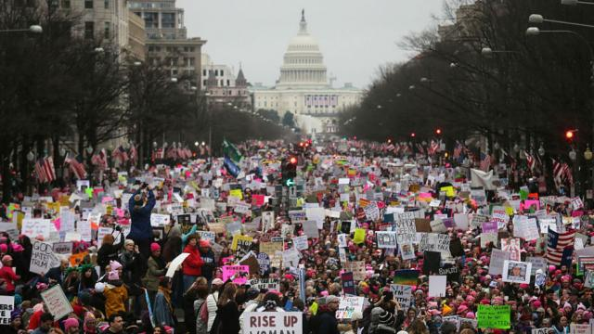
Walk-Outs
Process for Students
Excusals
Supervision
Sponsoring
Discipline
Communications with staff and parental notice

Slide 15
Students and Walkouts
Meet with the students planning to protest and address the following concerns:
Where are they walking out to? Safety, traffic, local laws.
How have they determined this is a safe area?
Are there safer alternatives?
Is it an organized and constructive protest?
Do all students know that not returning to class constitutes an unexcused absence?
Review the Student Code of Conduct as part of your conversation with the students.

Slide 16
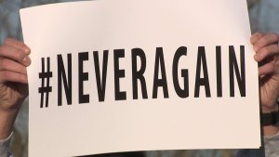
Students and Walkouts: Excused or Unexcused Absence
Generally, walkouts should be treated like any other unexcused absence.
Follow your schools’ attendance procedures and past practices.
This could include attendance consequences for the students.
Notes:
ORS 339.065 define what an excused absence is: “caused by the pupil’s sickness, by the sickness of some member of the pupil’s family or by an emergency.” The statute does not define what an unexcused absence is, other than by legislative silence.

Slide 17
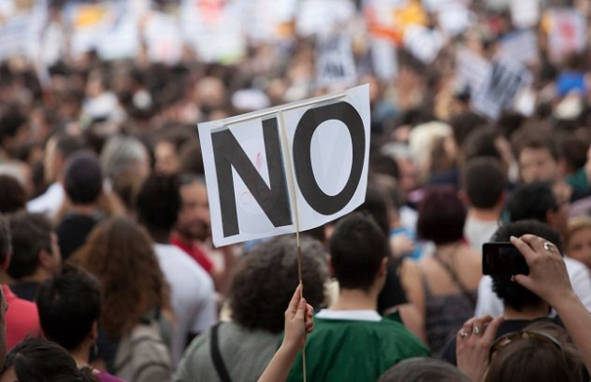
Staff Participation
Staff members cannot participate in political protests during the workday or use district resources to promote political activities.
This includes prep periods.
Staff members are free to participate outside of work.
Notes:
During a protest, staff members should remain at their assigned location and assignments.

Slide 18
PERCELL FOR PRESIDENT
Restrictions on Political Campaigning by Public Employees – ORS 260.432, p. 8.

Slide 19
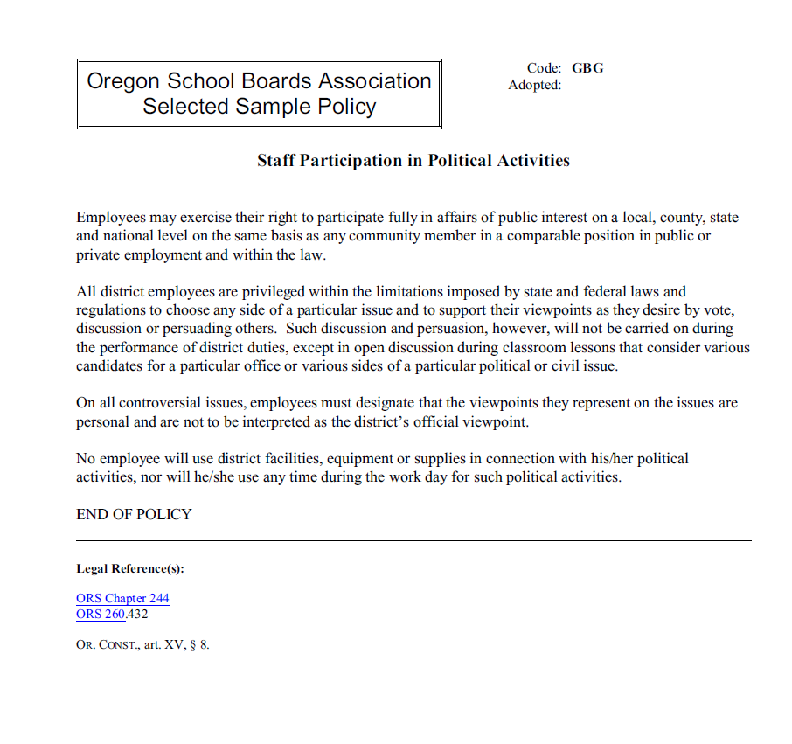
Policy GBG

Slide 20
Sponsoring
If a school allows students to gather on district property, then the protest is a school-sponsored activity and the school must:
Provide supervision
Maintain control of the situation
Be aware of non-student and community member participation.
Considering limiting attendance.
If supervised by district staff, the school is responsible for the safety of all students and staff.
The school may be perceived as endorsing the speech of the students.

Slide 21
Supervision
If protests are allowed to be on district grounds, it is appropriate to have staff supervising.
Be aware, providing space for student protest will create liability and an opportunity for opposing views and contrary student groups to also protest.

Slide 22
Students and Walkouts: Discipline
Students can only be disciplined for protesting if their actions and activities cause a disruption to the educational program. See Tinker. Attendance rules and procedures apply.
A walkout may not be enough to cause a disruption.
Yelling, screaming, and protesting as students walkout may be a disruption.
Schools cannot discipline based on the type of speech. That would be viewpoint discrimination and a violation of the First Amendment.

Slide 23
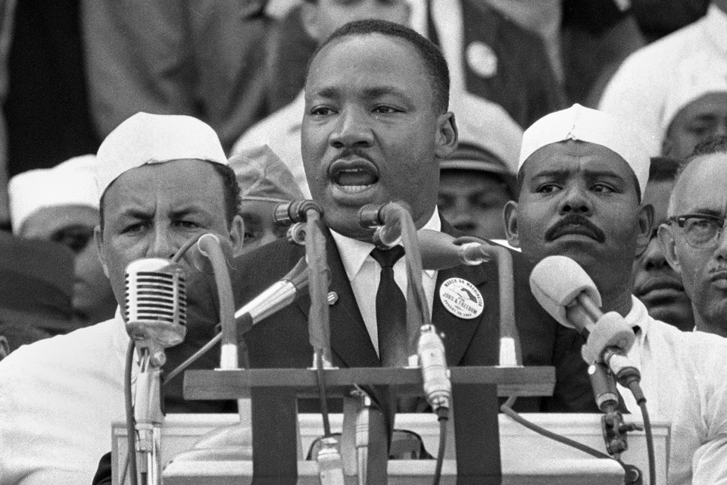
Communication with Students
Review your current procedures.
Communicate procedures to students.
Instruct the students on civil rights, history of civil rights, and use the opportunity to learn.

Slide 24
Communicate with Parents
Be able to answer the following for parents:
What is school’s procedure for walkouts?
What do you expect of students who protest?
What would result in discipline?
What needs to be done in order to excuse an absence? Make-up?
Will students be supervised?

Slide 25
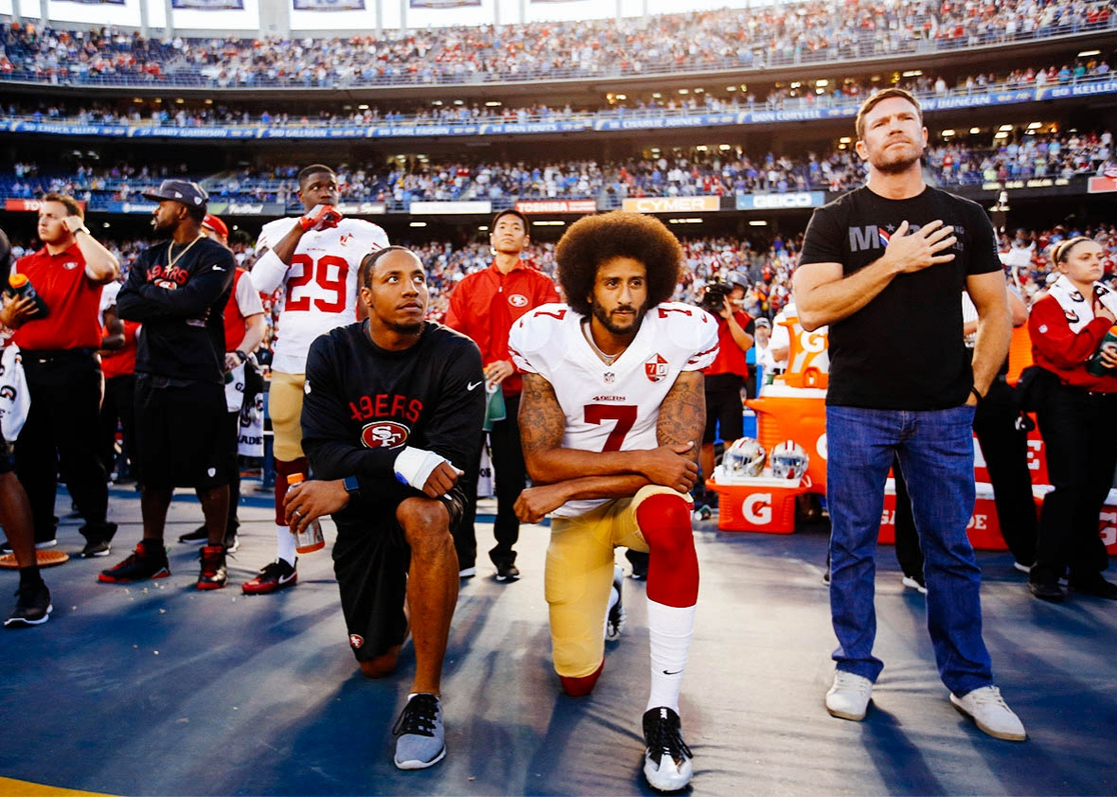
Other Types of Protests
Sit-in
Clothing
Signs
Organized Meetings
Kneeling
Again consider Tinker. Schools cannot censor student speech unless it will or is substantially and materially disrupting the educational process and mission.

Slide 26
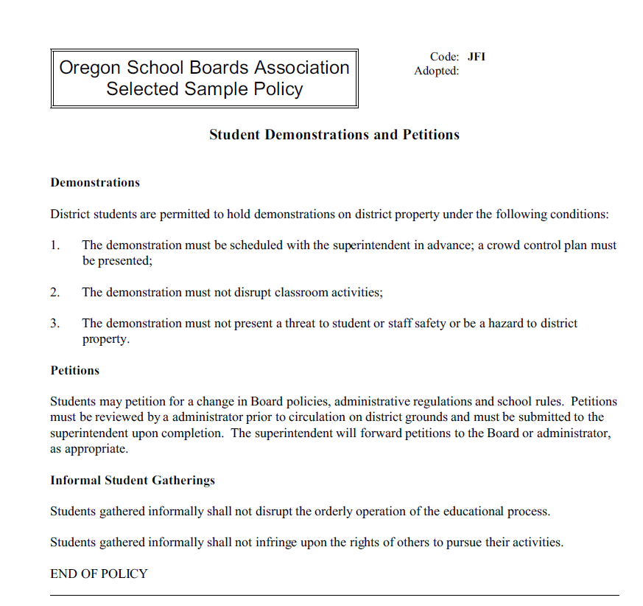
Policy JFI

Slide 27
PACE PRE-LOSS
For legal questions regarding anything discussed in this webinar, contact PACE Pre-Loss at pacepreloss@osba.org or 503-485-4800.
For OSBA model policies, contact OSBA’s Policy Department at 1-800-578-6722.
For Assistance with public media comments, contact OSBA’s Communication Department at apulaski@osba.org or 1-800-578-6722.

Slide 28
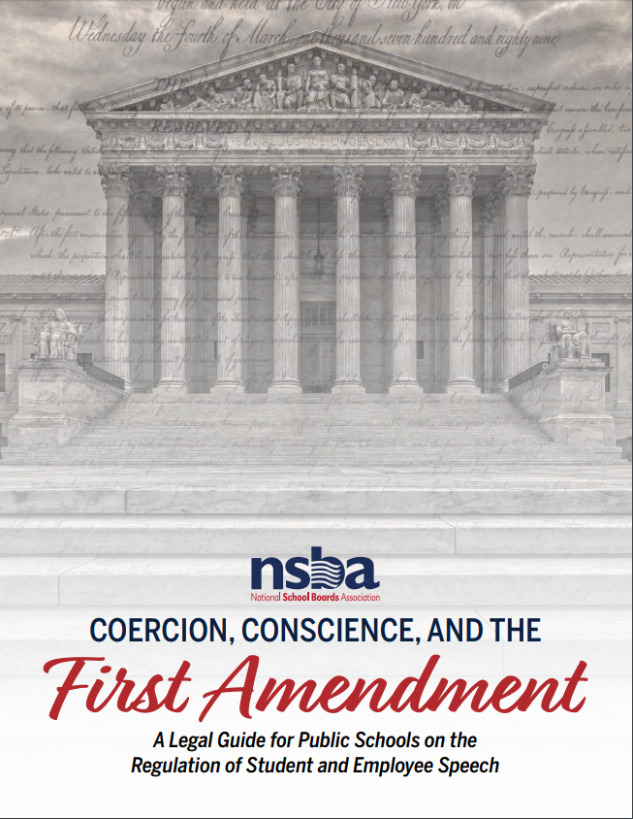
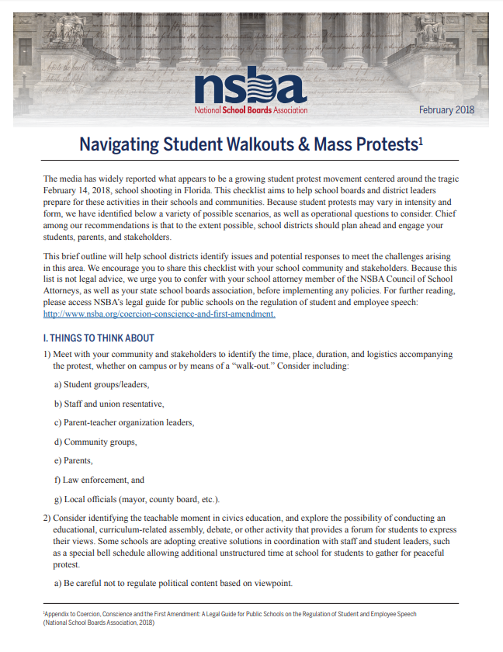
RESOURCES, NSBA

Slide 29
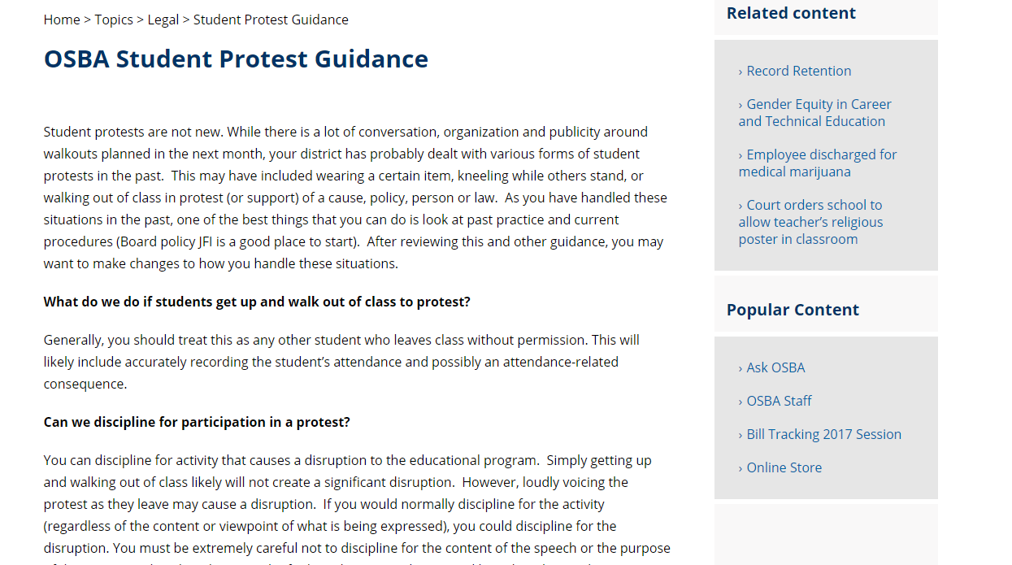
RESOURCES, OSBA

Slide 30
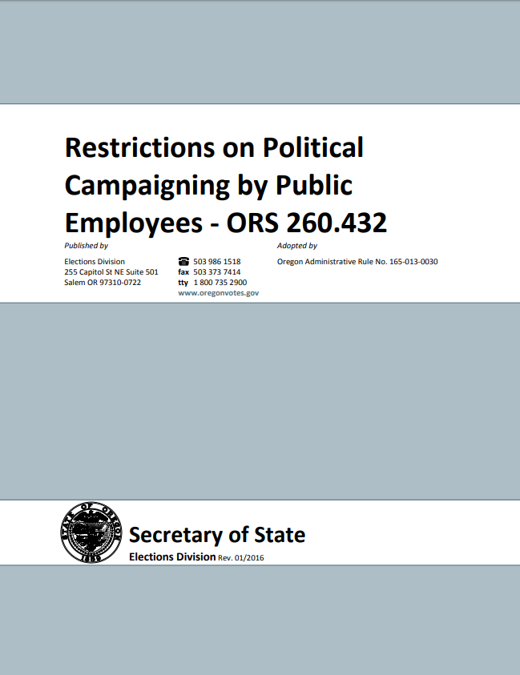
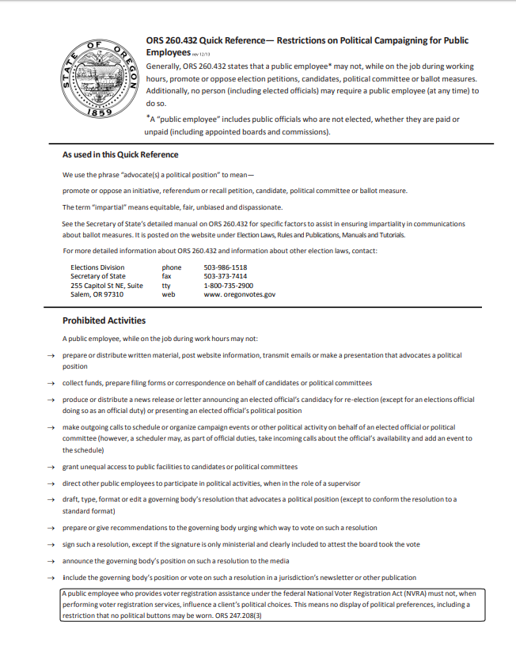
RESOURCES, Oregon SOS

